Slide 1
Speed Control of DC Motors using ANN (2nd Review)

Slide 2
TEAM MEMBERS:
B.SURAJ CB.SC.U4AIE24105
C.SAI KARTHIK CB.SC.U4AIE24107
VISHNU TEJA CB.SC.U4AIE24130
MOHAN INANI CB.SC.U4AIE24136

Slide 3
Project Overview:
We are optimizing our ANN-driven DC motor speed control system based on a feedforward neural network trained by the resilient backpropagation (trainrp) algorithm. The ANN is trained with simulation data from a highly detailed DC motor model, with electrical and mechanical dynamics represented under different load conditions. Embedded in Simulink, the ANN forms part of a closed-loop system, producing accurate control signals for PWM-based speed control with minimal overshoot and improved stability.

Slide 4
Methodology:
System Modeling: Develop a Simulink model that captures motor electrical (resistance, inductance, back-EMF) and mechanical (inertia, friction) dynamics using PWM-based closed-loop control.
Data Collection & Training: Collect simulation data (voltage, torque, speed) and train a feedforward ANN offline with resilient backpropagation (trainrp) to minimize MSE.
Integration: Embed the trained ANN in Simulink via a MATLAB Function block that retrieves the ANN from the workspace and generates real-time control signals.
Analysis: Compare ANN-based control with conventional PID using response metrics, error analysis, and convergence plots.

Slide 5
Understanding Function Block and Outputs:
Retrieves ANN: Uses evalin with coder.extrinsic to fetch the pre-trained ANN from MATLAB’s workspace.
Input Handling: Accepts a feature vector (fixed parameters, voltage, computed torque) matching training dimensions and transposes it as needed.
Prediction & Output: Processes the vector through the feedforward ANN (trained via trainrp) and transposes the output for Simulink compatibility.

Slide 6
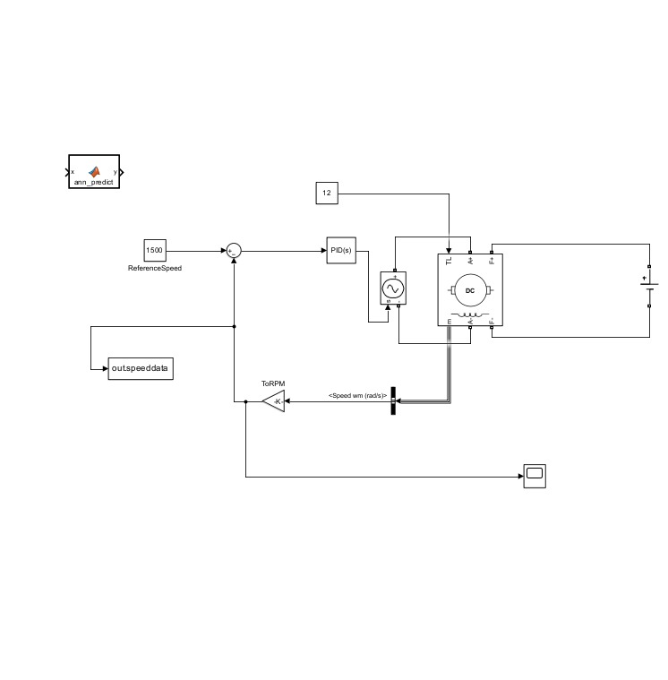
Simulink Model SIMULATION:
This image shows the Simulink model with the DC motor, control logic, and the ANN function block. It demonstrates the integration of our control algorithm, enabling real-time speed regulation.

Slide 7
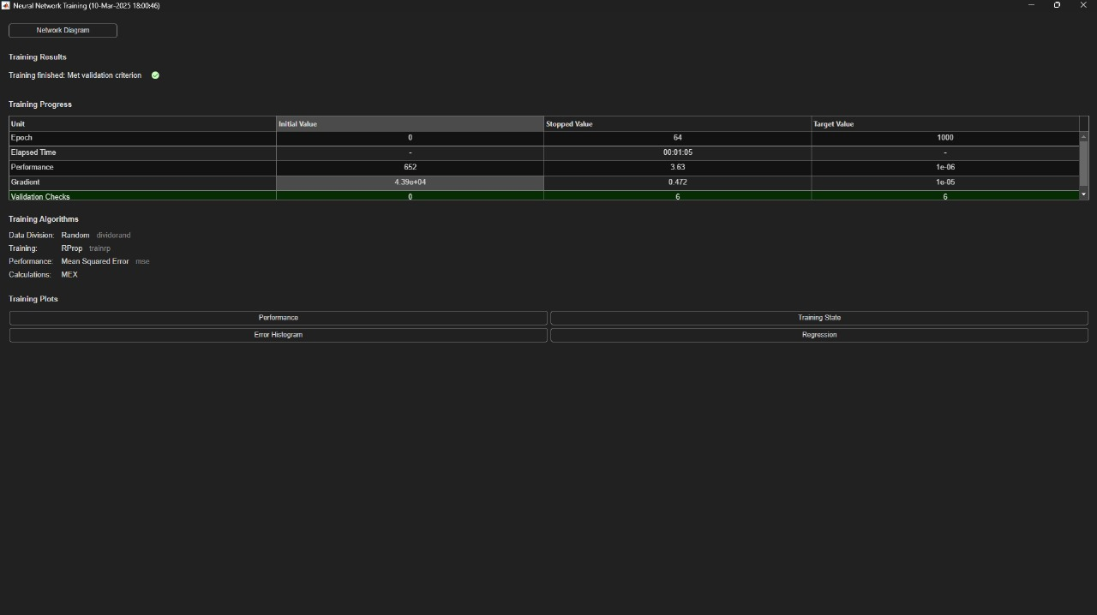
Neural Network Training Outputs:
Output 1: This output plot shows the decline of Mean Squared Error during training, indicating that the ANN is learning the nonlinear relationship between voltage, torque, and motor speed.

Slide 8
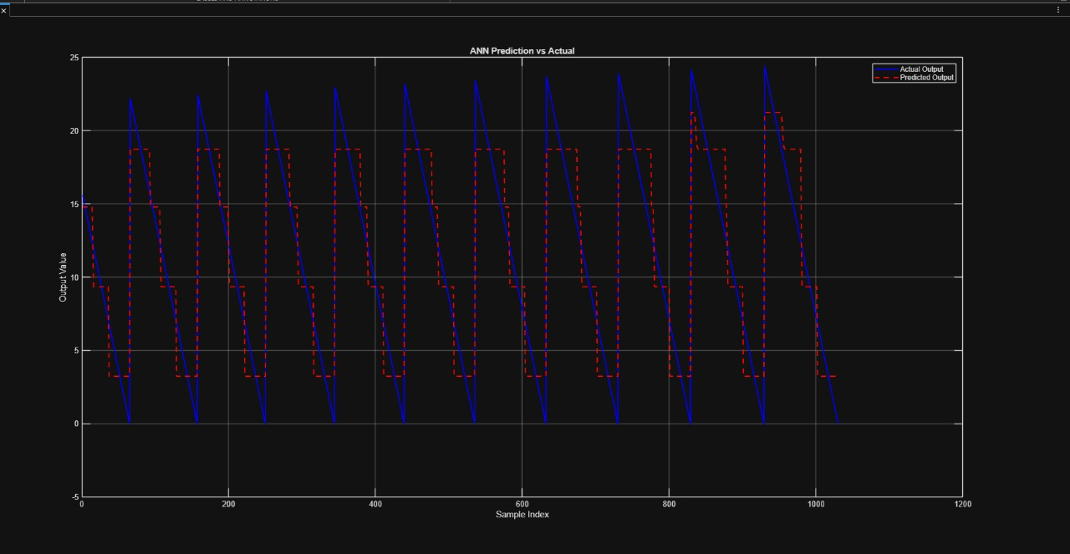
Output 2: This plot further validates the ANN’s performance, illustrating stable convergence and reliable predictions under varying conditions.

Slide 9
Challenges:
Data Availability: Gathering a comprehensive dataset for various load conditions remains challenging.
Multiple Inputs: Ensuring proper scaling and ordering in the ANN function block is complex.
Hardware Integration: Transitioning from Simulink to real hardware requires specialized interfacing.

Slide 10
Project Timeline:
Early March: Defining and Training the ANN.
Mid March : Integrting the ANN with the circuit and Creaing our own Dataset.
Late March : Training it with our Own Dataset and Refining the framework.

Slide 11
Thank You

